Slide 1
Introductory briefing to the Leicester, Leicestershire, and Rutland (LLR) guidance: Responding To Self-Neglect (including Hoarding)
Published October 2024
Presented by: Alison Taylor-Prow, Chair of the LLR Learning & Development Subgroup

Slide 2
Introduction
This guidance will support you as a front line professional to work with people who are at risk of self-neglecting or hoarding. It replaces the LLR Vulnerable Adults Risk Management Guidance (VARM).
The guidance provides a risk assessment tool to support you to identify whether the person’s self-neglect or hoarding is low, moderate, or high risk.
Where a person is assessed as low or moderate risk, you should work flexibly with the person and colleagues in a multi-agency approach to achieve the best outcomes for them.
The guidance does not, specify which agencies need to be involved nor does it prescribe any specific actions that may need to be taken.
You will need to decide the responses based on the person’s individual circumstances as well as the eligibility criteria of partner agencies.

Slide 3
Aims and Objectives
To introduce LLR to the new self neglect and hoarding guidance and the supporting 7 minute briefings.
To explain that after 1st December the VARM (Vulnerable Adults at Risk Management) is no longer in use.
To explain the criteria for self neglect under the Care Act.
To present the three levels of risk defined in the procedure and explain roles and responsibilities at each level.
To highlight how to address professional differences.

Slide 4
Why do people self-neglect and hoard?
There are complex interconnecting social, psychological, and contextual reasons why people self-neglect or hoard, key reasons are:
Sometimes self-neglect and hoarding are associated with some kind of trauma.
Physical and social changes due to ageing
Brain injury, sometimes related to alcohol consumption, dementia, stroke accident or other neurological causes.
Addictions- this can be substances or items such as newspapers or animals.
Self-neglect and hoarding can be an indicator of mental distress however, many people who hoard do not have an additional psychiatric disorder.
British Psychological Society (2024) & Research in Practice (2020)

Slide 5
When is self-neglect or hoarding a safeguarding concern?
When a person’s self-neglect or hoarding is impacting on their well-being.
they have care and support needs (whether or not the local authority is meeting any of those needs).
and because of those care and support needs they are unable to protect themselves from neglect.

Slide 6
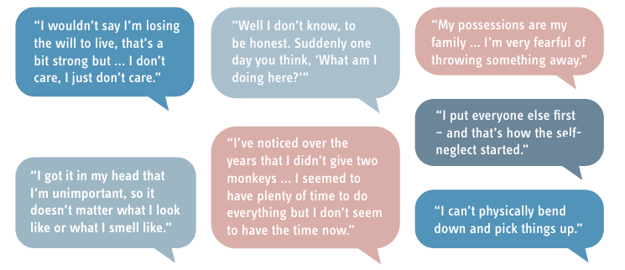
Centring the voice of the adult
Self-neglect or hoarding can occur in people of any race or culture. However, it is important that professionals
have an awareness of the person’s cultural heritage. You cannot be an expert in every culture.
(Research in Practice, 2020).

Slide 7
Establishing risk and responses
Practitioner has a concern that a person is self-neglecting, in all situations please:
Assess the person’s circumstances using the LLR Self-Neglect (including hoarding) Guidance.
Does the adult have care and support needs arising from a physical or mental impairment?
Is a decision specific (e.g. care and support needs, medication management, etc) capacity assessment required?
Has the person had key decisions regarding social care and health needs assessed under the MCA?
What are the adults views regarding the self-neglect concerns and what outcomes do they want?
Are there any carers involved?
Does the self-neglect impact on any other adults at risk or children?

Slide 8
Levels of risk
Low Risk
Practitioner has considered and concluded that the adult has capacity to make decisions regarding their social care and health needs; and the risk of self-neglect is currently low.
Moderate Risk
Practitioner has considered and concluded that the adult has capacity to make decisions regarding their social care and health needs and the risks posed by any self-neglect.
High Risk
Take immediate action to ensure the safety of the adult.
Follow own organisation’s escalation process.
Complete a safeguarding adult referral (alert) to Adult Social Care for section 42 concerns.

Slide 9
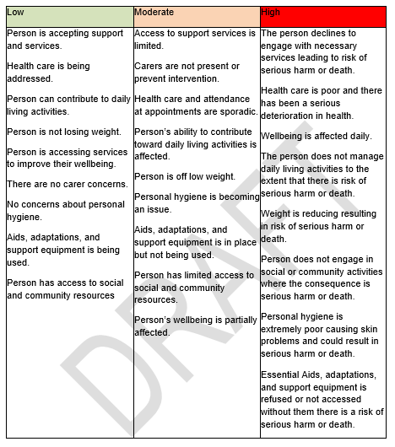
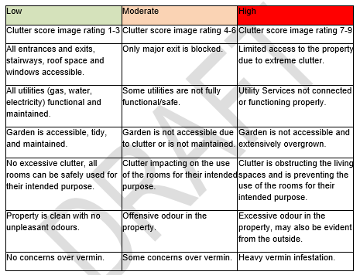
Levels of risk
Pages 8 and 9 of the guidance…

Slide 10
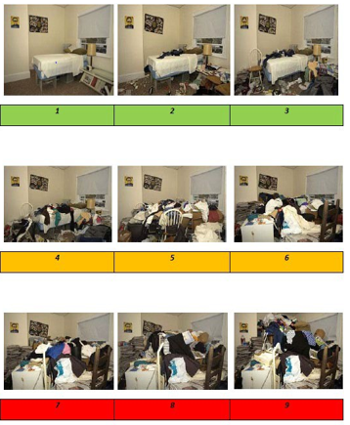
Levels of risk
See pages 18, 19 and 20 of the procedure for further clutter
Index rating examples...

Slide 11
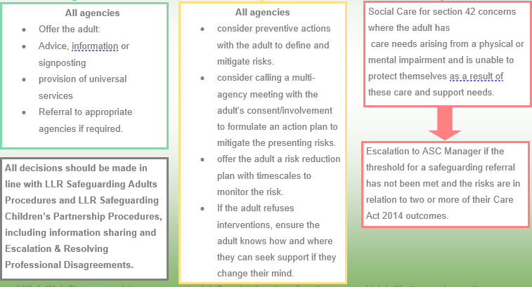
Levels of risk
Low, Medium and High

Slide 12
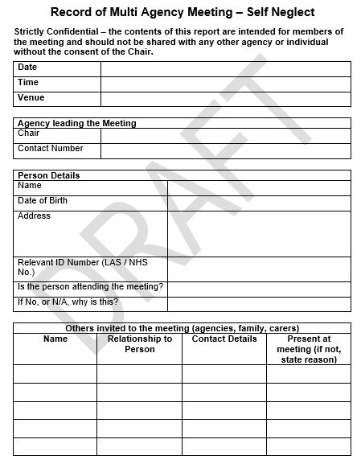
Documenting meetings
Appendix 2, pages 21-26 provide example templates for multi-agency meetings.
Learning from audits and reviews indicate that professionals do not consistently document their actions using the multi-agency templates.
Please use the templates

Slide 13
Summary
The guidance is designed to support practitioners to identify and respond to all levels of risk in self-neglect and hoarding.
It is built on the research and the available legal frameworks around self-neglect, hoarding and safeguarding.
It replaces the VARM.
The guidance does not, specify which agencies need to be involved nor does it prescribe any specific actions that may need to be taken.
If you require support when working with adults who self-neglect or hoard, please speak to your line manager or agency safeguarding team or lead.
Self-neglect and hoarding is a complex issue, it’s important agencies work together.

